Slide 1
GPS DETECTER PROJECT
Lê Hoàng Giang – 1551032
Vương Minh Phú - 1551112

Slide 2
Overview
Solution
Necessary Framework
Local website
Restriction and problems
Reference

Slide 3
I/ Solution
What is GPS?
How to get GPS?
Detect position

Slide 4
1/ What is GPS?
The Global Positioning System (GPS), originally Navstar GPS, is a satellite-based radionavigation system owned by the United States government and operated by the United States Air Force. It is a global navigation satellite system that provides geolocation and time information to a GPS receiver anywhere on or near the Earth where there is an unobstructed line of sight to four or more GPS satellites. Obstacles such as mountains and buildings block the relatively weak GPS signals.

Slide 5

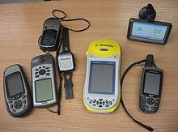
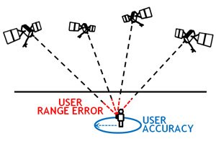
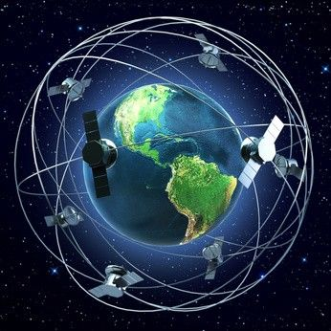

American Government.
30 satellites, 27 work, 3 back-up.
20200 km, 7000 miles/h.
3 for longitude and latitude, 4 for height.
6 controller station, 1 center and 4 automatic, 1 back-up.

Slide 6
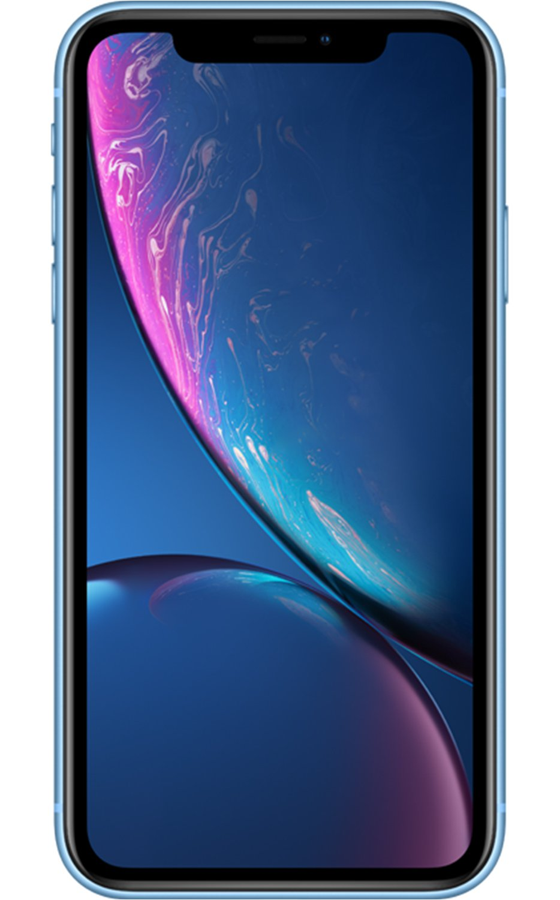
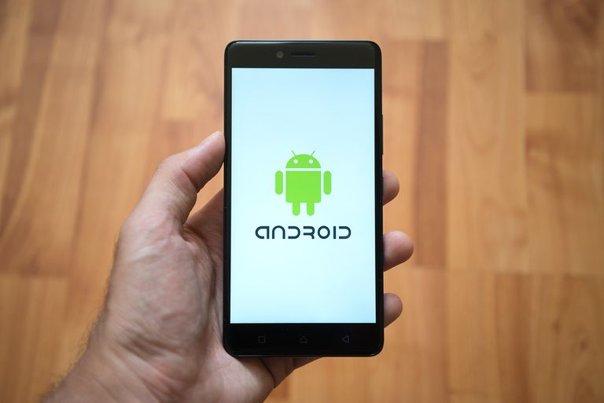
2/ How to get GPS?
Build Android application to take the location.
Framework and library support.
Weak security.

Slide 7

3/ Detect position
Google API:
+ Clear tutorial and support for research
+ More than 200 countries data and cover 99% area of Earth.
+ Over 25 millions location’s updates from collaborators and Google Local Guide teams around the world.

Slide 8


Receive data
An website:
+ Receive data
+ Commute with API map
+ Good outlook

Slide 9
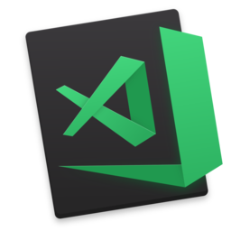
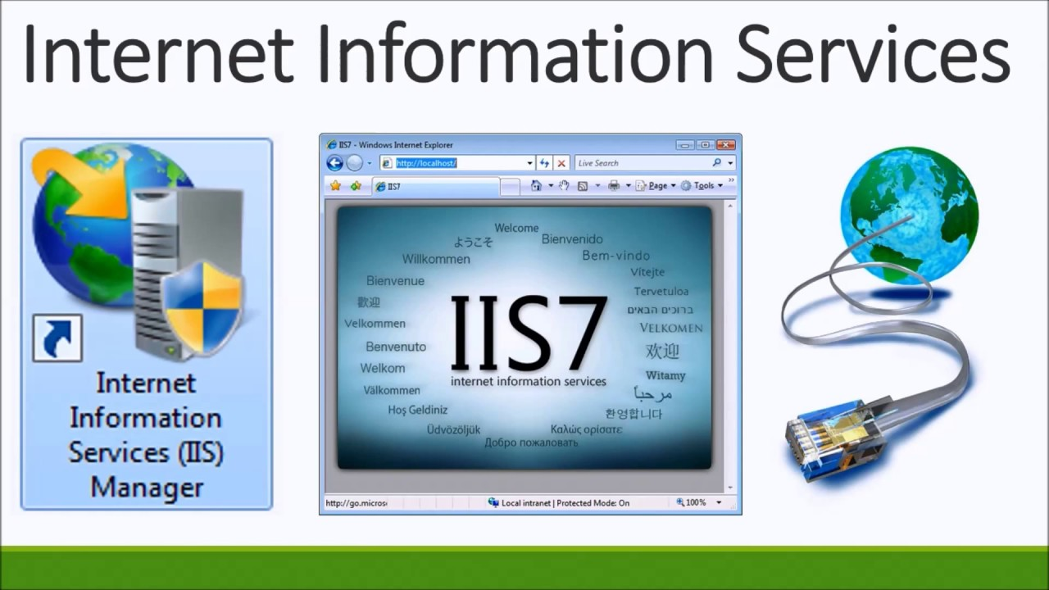
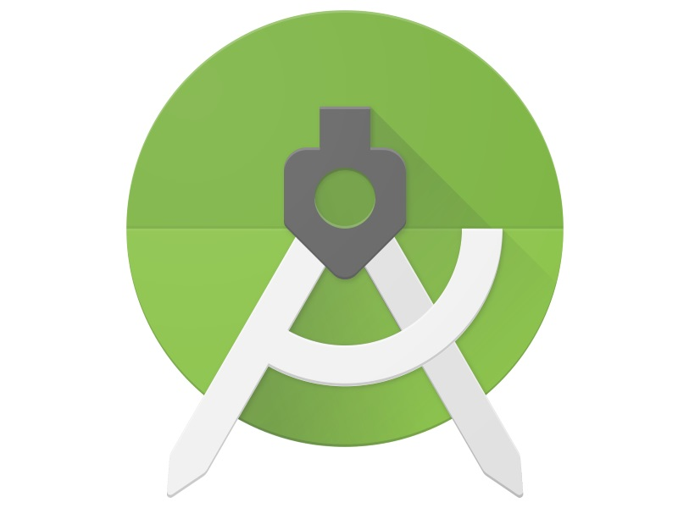
II/ Necessary framework
Visual Studio Code Insider
Internet information services manager (IIS)
Android Studio

Slide 10
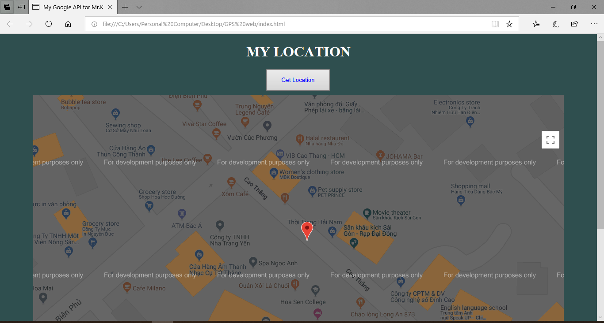
III/ Local website

Slide 11
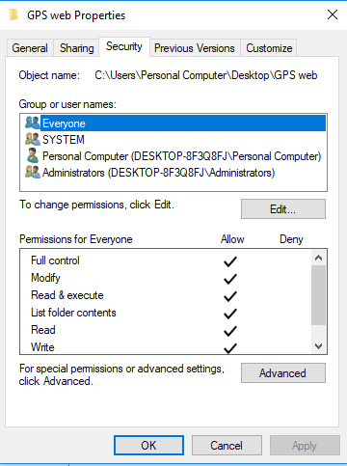
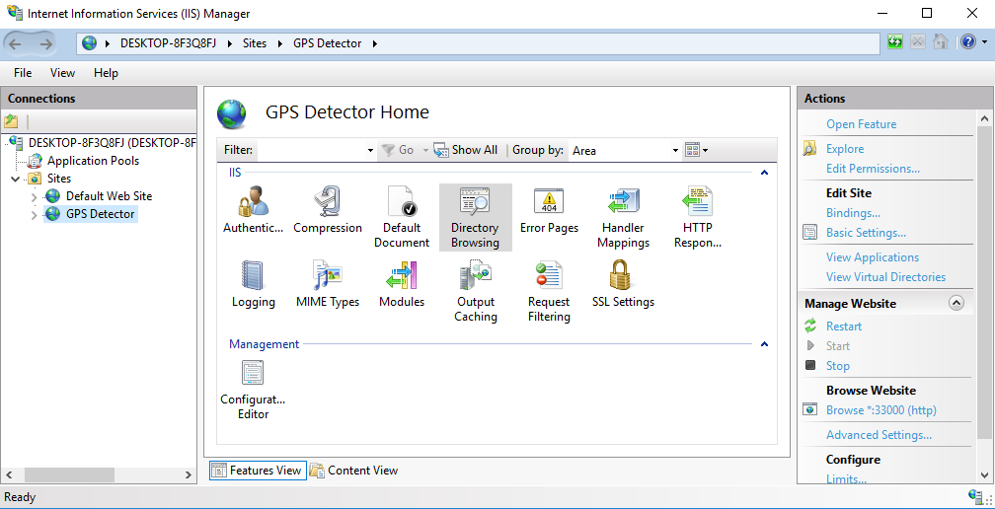
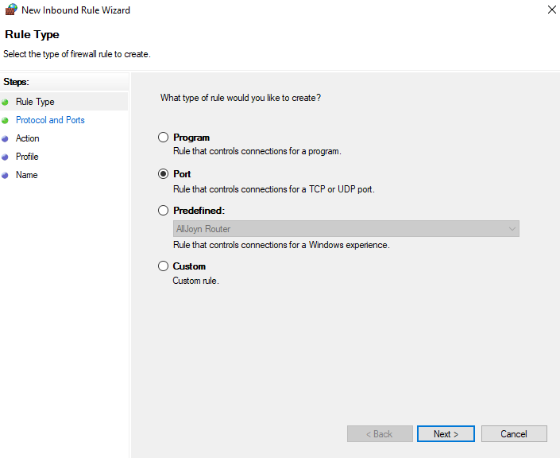
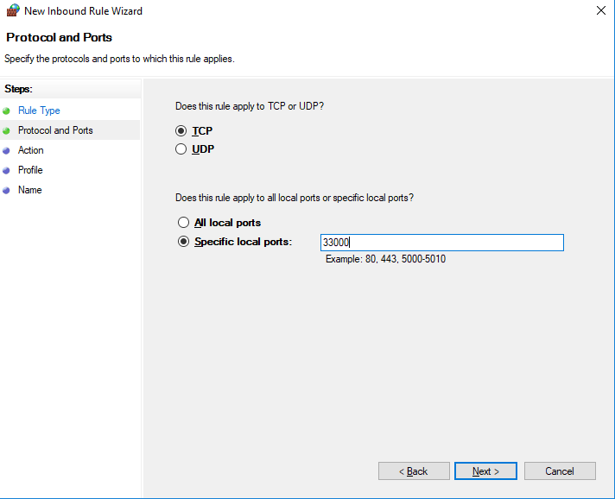
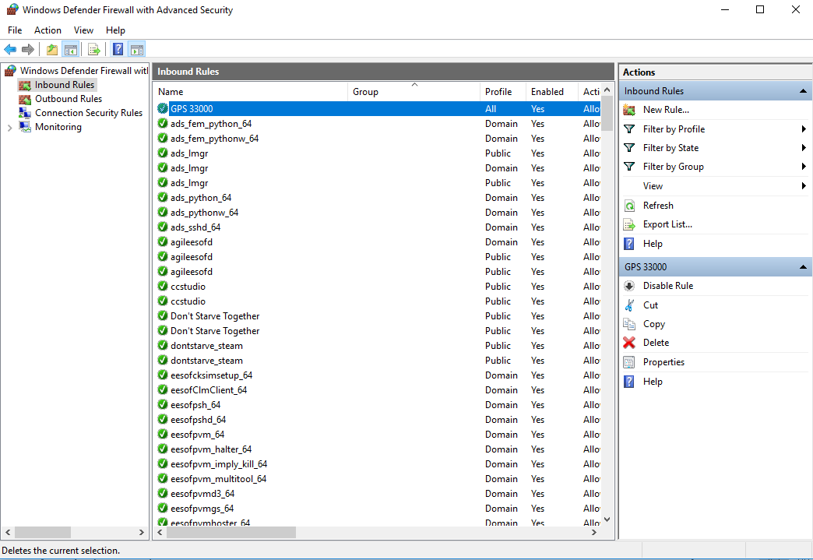
Make the html file become website with IIS
Create a website in IIS.
Allow permission for all user.
Allow firewall to open my port

Slide 12
IV/ Restriction and Problem
Problem
+ Can’t send data
+ First time at HTML, CSS, Android Studio.
+
+
+
+
+
Restriction
+ Local web
+
+
+
+
+
+

Slide 13
V/ References
Stack Overflow: https://stackoverflow.com/
Wikimedia: https://en.wikipedia.org/wiki/Global_Positioning_System
W3School: https://www.w3schools.com/
Android Studio: https://developer.android.com/docs
Devside: https://www.devside.net/wamp-server/accessing-websites-on-a-local-network-lan-web-server
Github: https://github.com/

Slide 14


Slide 15


